Slide 1
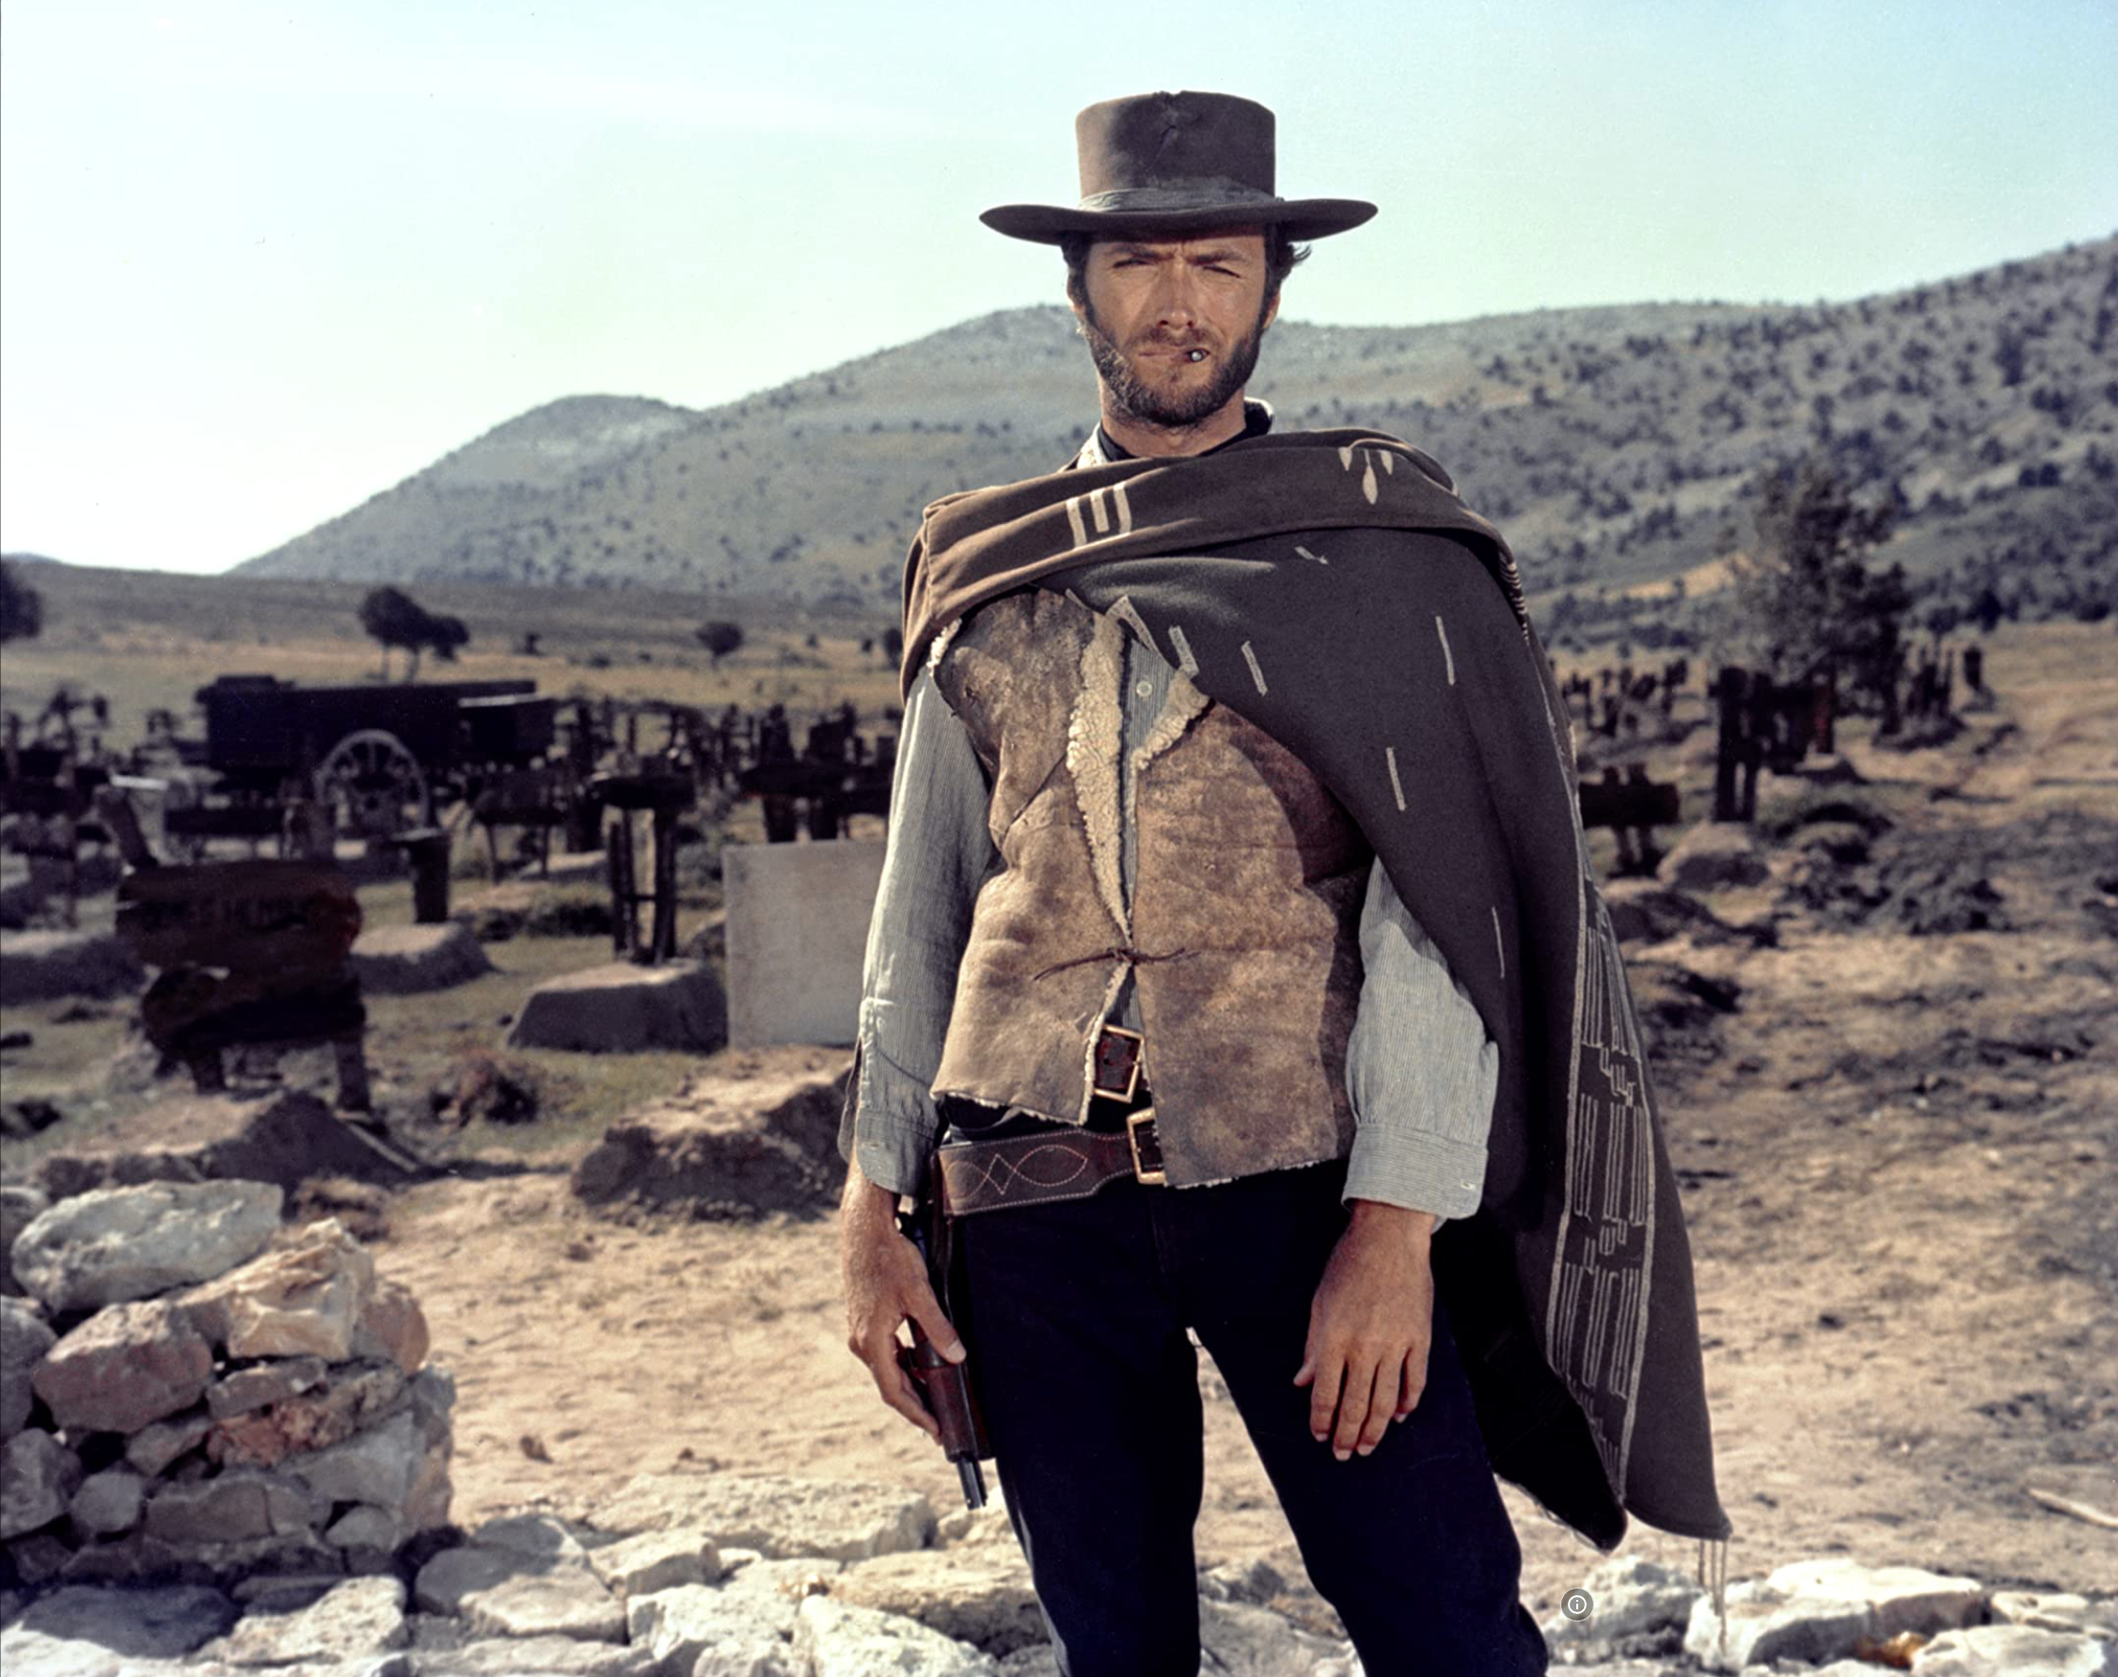

The Easy, the Hard and the Ugly
Easy
Inference (fit)
Fine-Tuning (predict)
Hard
Pre-training
Ugly (Responsible AI)
Bias
Toxicity
Misinformation
Hallucinations
Plagiarism

Slide 2
Ugly: Outline
Benchmarking (Omar)
Smooth-Talking Machines/Trust (Ken)

Slide 3
Evaluating Evaluations: A Perspective on Benchmarks

Slide 4
The importance of evaluation
More and more benchmarks, data sets and evaluations available
Industry ships a new product/feature …
… users test it, high expectations, harsh reaction …
… back to the lab to fix things, iterate; very expensive process
As a community:
Are we really evaluating the right stuff?
Are we using solid principles to construct and maintain benchmarks?
What are we learning?

Slide 5
Principles (Spoiler Alert)
Characterize use case & audience
Validity:
Relevance of task to use case
Reliability:
Inter-rater agreement
Realistic workloads
Labeling and annotation
Documentation:
How was it done?
Availability of instructions
Maintenance
Include a feedback loop mechanism to maximize adoption
Workload Evolution
Lessons learned and addendum(s)
Lifecyle and deprecation
High standards
(for high-stakes use cases)
Use of established software engineering and data management techniques
(e.g., code review, versioning, configurations, dependencies, and testing).
How was the data sourced?
Provenance?
Can we data set be generated again easily?
Clean and well-documented data model

Slide 6
Validity and Reliability Krippendorff (2018) Content analysis: An introduction to its methodology
Reliability is about data, and validity is about truth:
Reliability:
The attribute of Data on which researchers can rely in answering their Research questions – Krippendorff, p. 411
Validity:
The quality of a claim to be as stated, true, or correct. – Krippendorff, p. 413
Validity assumes a hypothesis/claim.
Hard to test validity without a clearly stated hypothesis
There are more papers on reliability than validity in our field(s).
18k matches for “inter-annotator agreement” in ACL Anthology
https://aclanthology.org/search/?q=inter-annotator+agreement

Slide 7
Reliability of BLEU https://aclanthology.org/P02-1040/
The original paper asks 3 excellent questions about reliability
How reliable is the difference in BLEU metric?
What is the variance of BLEU score?
If we were to pick another random set of 500 sentences,
would we still judge S3 to be better than S2?

Slide 8
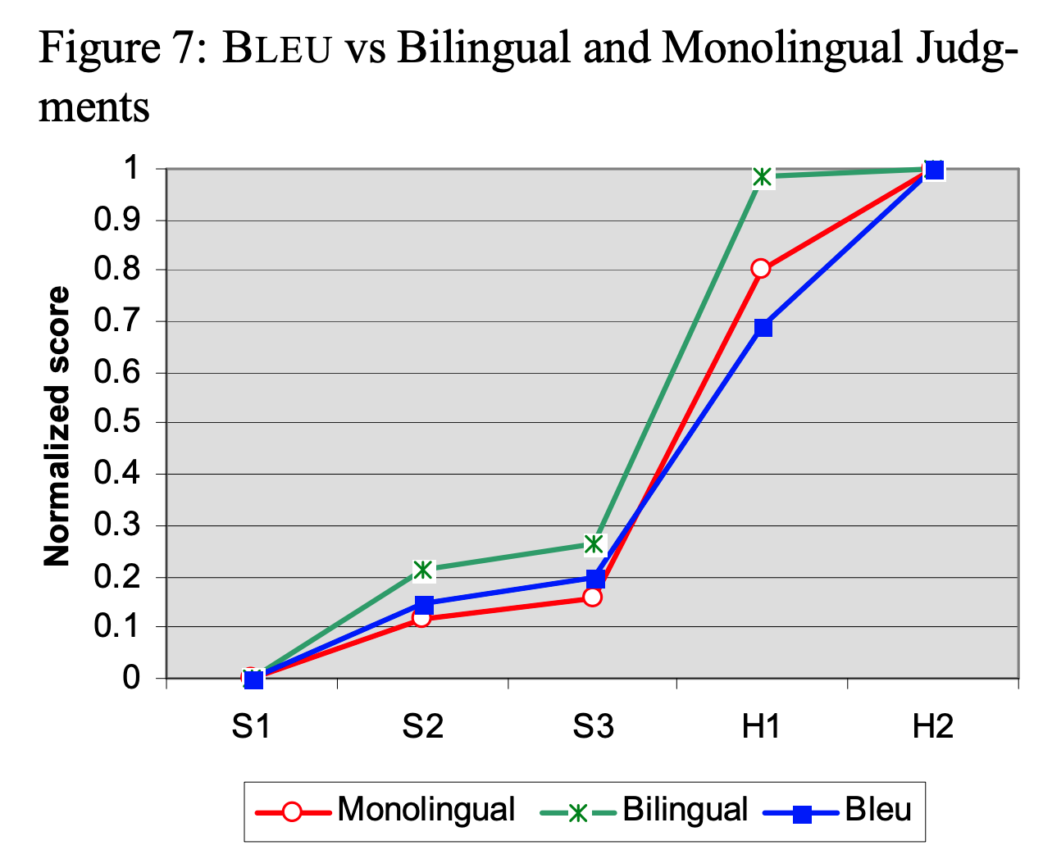
Reliability of BLEU
In their Figure 7,
they use BLEU to compare three machine translation systems (S1, S2 and S3) and
two human (non-professional) translators (H1 and H2).
They report that humans score better than machines.
They conclude:
“BLEU’s strength is that it correlates highly with human judgments
by averaging out individual sentence judgment errors over a test corpus
rather than attempting to divine the exact human judgment for every sentence:
quantity leads to quality.”
https://aclanthology.org/P02-1040/

Slide 9
Validity of BLEU
Less discussion of validity in original paper
Some papers raise serious questions about validity
of BLEU and other metrics
at least, for some use cases that go beyond the original BLEU paper
It is hard to talk about validity without a clearly stated use case
https://aclanthology.org/D17-1238/
This paper shows that state-of-the-art automatic evaluation metrics for NLG systems
do not sufficiently reflect human ratings,
which stresses the need for human evaluations.
https://aclanthology.org/J18-3002
Overall, the evidence supports using BLEU for diagnostic evaluation of MT systems
(which is what it was originally proposed for),
but does not support using BLEU outside of MT, for evaluation of individual texts, or for scientific hypothesis testing.

Slide 10
Use Cases
BLEU was originally proposed
to compare a small number of systems for DARPA competitions.
But soon after BLEU was introduced,
Och suggested using BLEU for a very different use case.
It had been standard practice to to use
different metrics for testing and training.
Och found that if one is going to use BLEU to evaluate systems,
then his system would do better in the evaluation if he also used BLEU for training.
Och’s suggestion did well in competitions,
but raises questions about reliability and validity

Slide 11
Consequence of Evaluation: Proposed Scale
Minor: e.g., SOTA-chasing, leaderboards
Moderate: e.g., Multitask learning
Generalizing results over workloads and tasks.
Major: e.g., Och training
Significant consequences for system performance
Mission Critical: e.g., SPEC
What should I buy? And what performance should I expect on my workloads?
Go/No-go decisions

Slide 12
Averaging: Arithmetic vs. Geometric
There are many benchmarks in our field:
e.g., GLUE, SciRepEval, MS MARCO and Big Bench
Many designed for SOTA-chasing,
but hopefully, results will generalize to more important use cases.
More likely to generalize to more important use cases
if they were designed to do so in the first place
SPEC was designed to report performance relative to baseline
How much better is the candidate CPU relative to VAX 11/780?
On the user’s (unspecified) workload?
Mashey argues that
geometric means generalize better
over workloads than arithmetic means.
Mashey suggests that results on our benchmarks would
generalize beyond less important SOTA-chasing use cases
if we replaced arithmetic means with geometric means in GLUE
(and many of our other benchmarks).

Slide 13
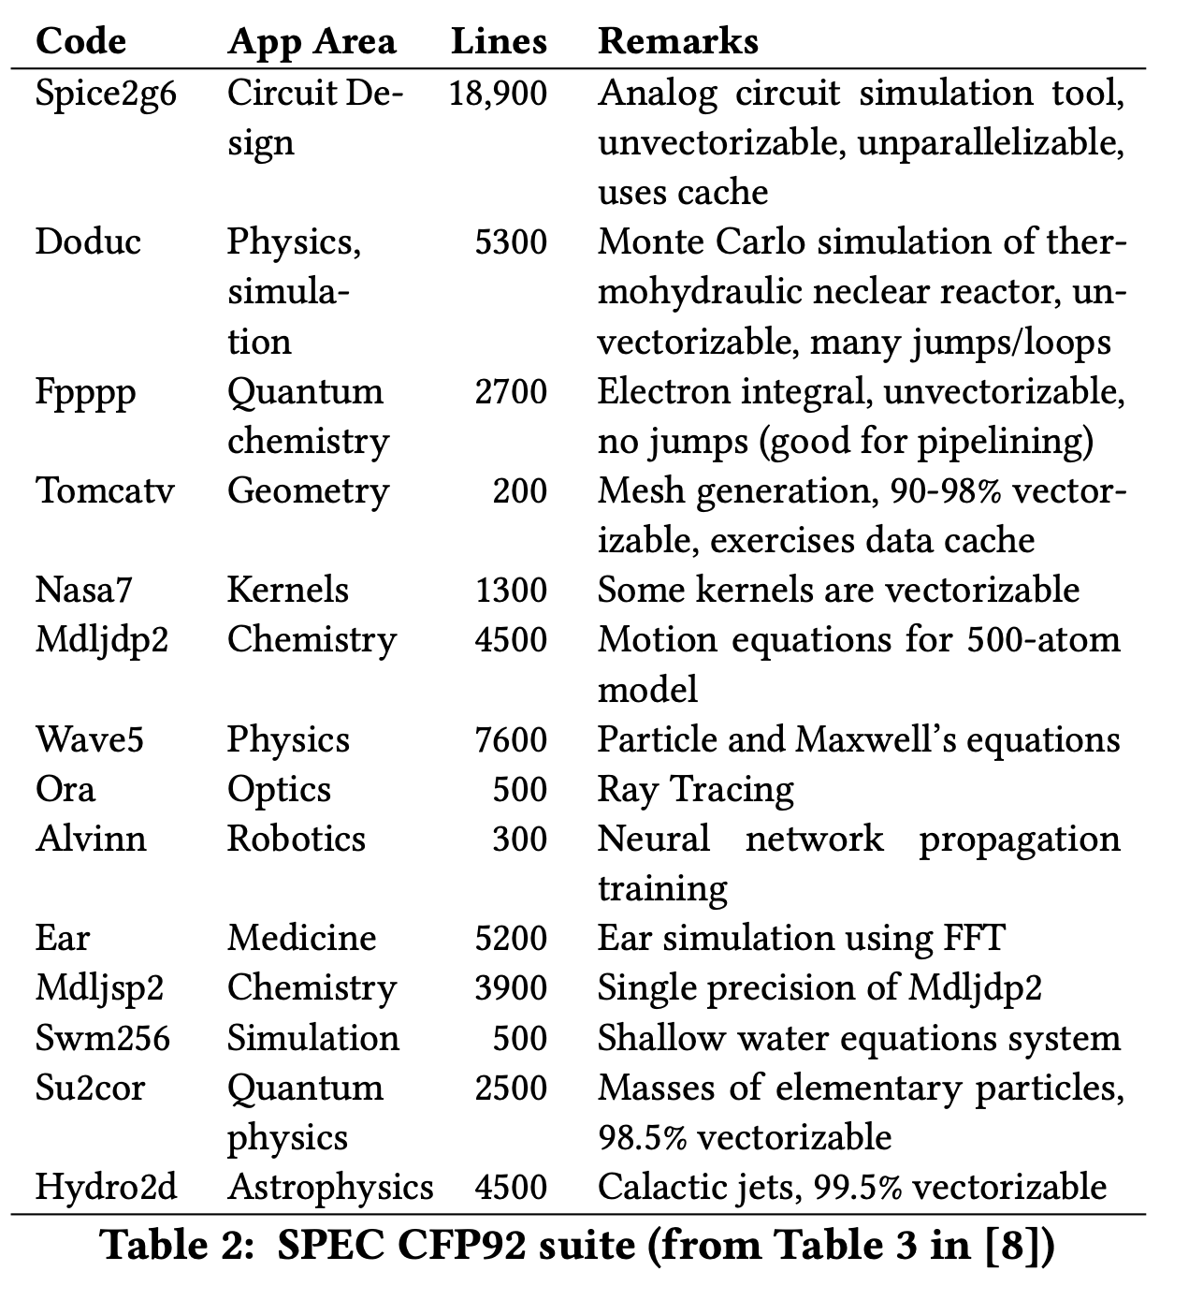
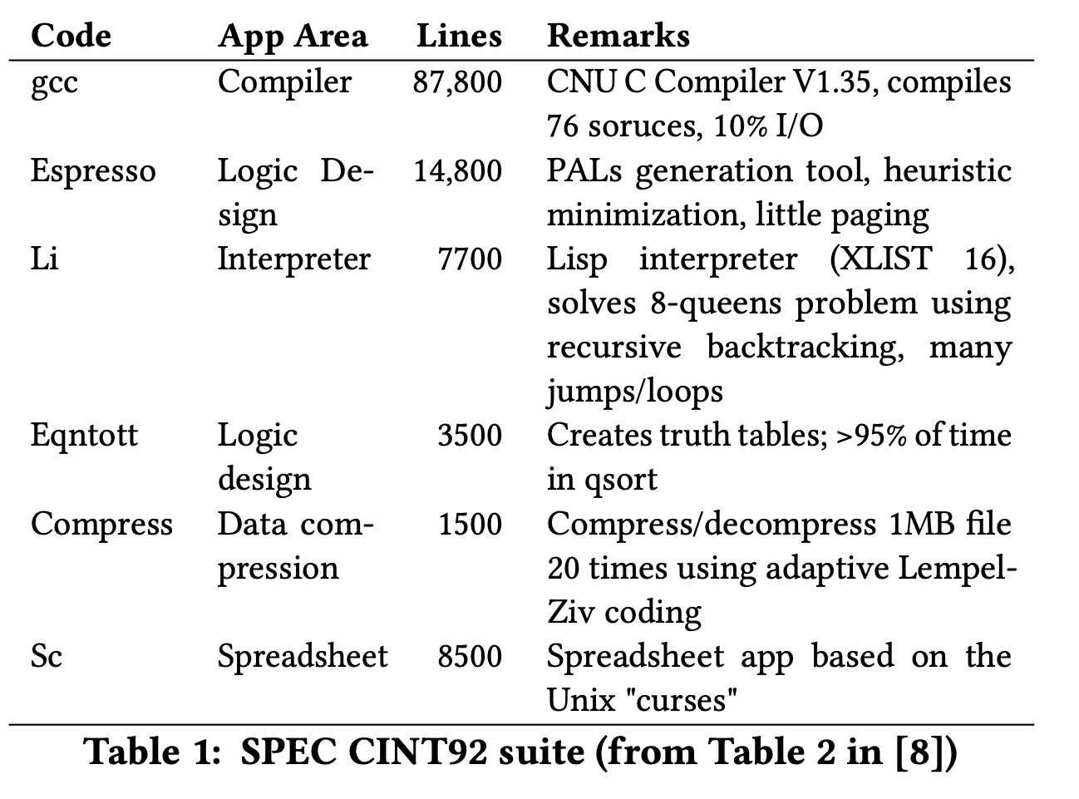
SPEC: A benchmark for evaluating CPUs

Slide 14
Challenges for Validity and Reliability
Unrepresentative Samples
Test/Train Splits: Interpolation vs. Extrapolation
Leakage
Labeling and Inter-annotator Agreement
Too many (irrelevant) tasks

Slide 15
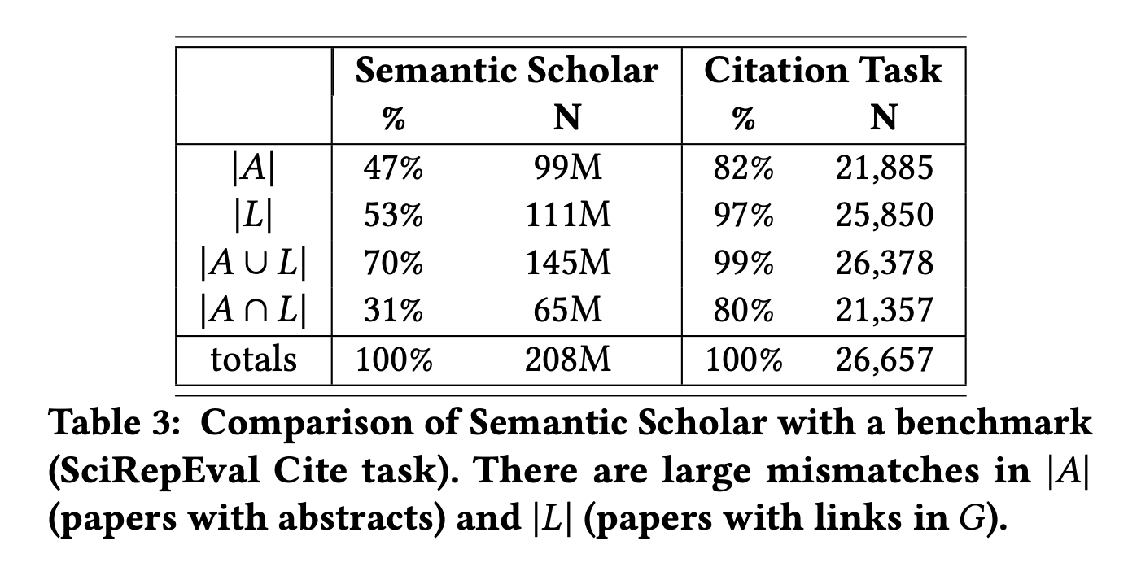
Unrepresentative Samples
Ideally, a benchmark should be
a representative sample
of a larger population of interest.
Balanced Corpora:
1960s: Brown Corpus
1990s: British National Corpus
Current view: catch as catch can
there is no data like more data – Mercer
Representative samples → More credible generalizations

Slide 16
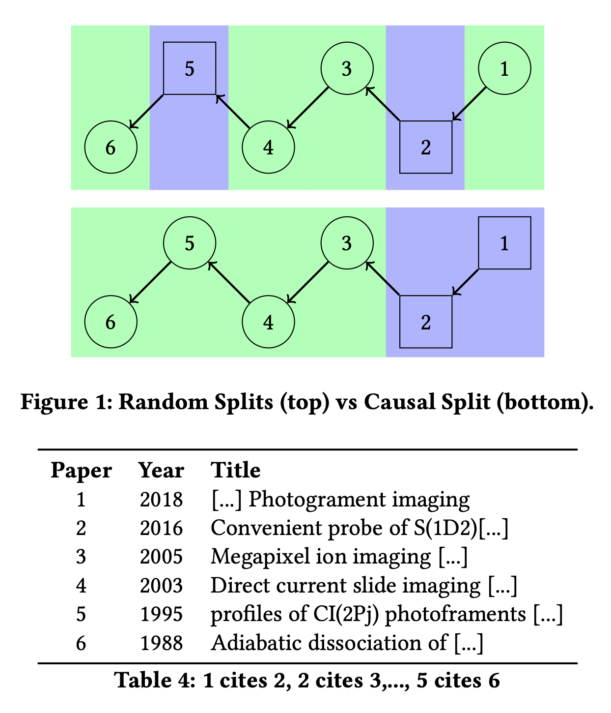
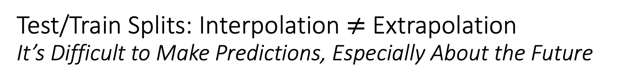
Test/Train Splits: Interpolation $≠$ Extrapolation It’s Difficult to Make Predictions, Especially About the Future
It is common for graphs to evolve over time.
For example, the academic literature is growing very quickly,
doubling every nine years
Benchmarks such as OGB focus on static snapshots from a few years ago,
missing opportunities to encourage the community to study growth and timeliness.
Random splits are common in graph learning benchmarks, e.g., WN18RR,
a popular Knowledge Graph Completion (KGC) task based on WordNet

Slide 17
Leakage
Leakage is common in many benchmarks
There is considerable discussion of leakage in SciDocs
(see 4.2 of https://aclanthology.org/2022.emnlp-main.802/)
WN18 → WN18RR (WordNet benchmarks)
If 𝑥 is-a 𝑦 (a car is a vehicle),
then there will be two links between x and y: hypernym and hyponym
Since WN18 randomly splits links into test and train,
one of these links is likely to be in test and the other in train
Unfortunately, WN18RR corrects some (but not all) of the leakage
See table 4 of https://aclanthology.org/2021.emnlp-main.501/
Despite this leakage, there are many papers on WN18RR
https://paperswithcode.com/dataset/wn18rr

Slide 18
Labeling and Inter-annotator Agreement
The documentation on SciRepEval makes it clear that some labels are “silver” (less reliable) [underlining added]:
... a new large-scale field of study (FoS) multi-label training set of more than 500K papers with silver FoS labels based on publication venue
We compared FoS labels in SciRepEval with FoS labels in MAG and found large differences.
More agreement in some fields (Computer Science)
Less agreement in History, Sociology and Art.
It is possible that the annotators
are more familiar with Computer Science
than History, Sociology and Art.

Slide 19
The bad news first
Labeling is hard
Facebook
Points-Of-Interests (Foursquare, etc.)
Labeling is going to get more difficult
Enterprise
Personalization
Healthcare
New data sets
Some context
We assume supervised or semi-supervised learning
Large scale
Continuous

Slide 20

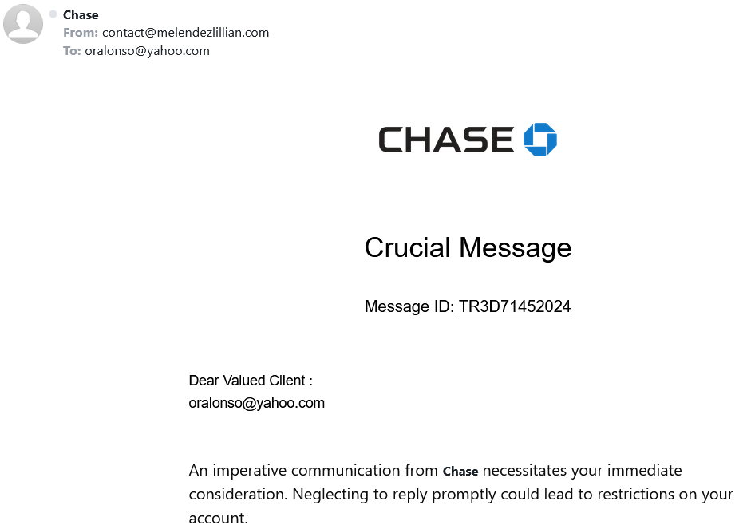
What is a label?
Spam email?
Label: yes, no

Slide 21
Why we care?
Provenance
Reproducibility & debugging
Explainability & interpretability
How a training set was created
Bias and fairness
Data management
ML/AI models live & die by the quality of input data
Metadata about labels
Maintenance
Lora Aroyo et al. "Data excellence for AI: why should you care?" Interactions 29(2): 66-69 (2022)

Slide 22
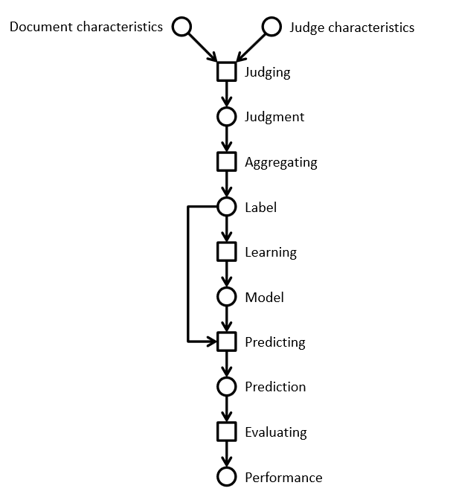
Lifecycle of a label
Information retrieval example
Using a crowd to label a data set
Using ML to process the complete data set

Slide 23
Relevance labels
Indicate whether a search result is valuable to a searcher
Key in evaluation and optimization IR systems
Editors or experts
TREC-style
Crowdsourcing
LLMs

Slide 24
Careful with that axe data, Eugene
In the era of big data and machine learning
labels -> features -> predictive model -> optimization
Labeling perceived as boring
Tendency to rush labeling
Quality is key
Garbage in, garbage out
Own the entire stack
Labeling, modeling, infrastructure, deployment

Slide 25
The state of the field
Human-labeled data is more important than ever
Requirements
Throughput -> ASAP; I need the labels for yesterday
Cost -> cheap; if possible free
Quality -> top
Performed as a one-off by 3rd party (crowd or editors)
Human Intelligence Task (HIT)
Micro-tasks
Needs development work to get good results
Very limited functionality in current platforms
Mechanical Turk, SageMaker (Amazon)
Figure Eight (Appen)
Toloka (Yandex)
Start-ups
LLMs

Slide 26
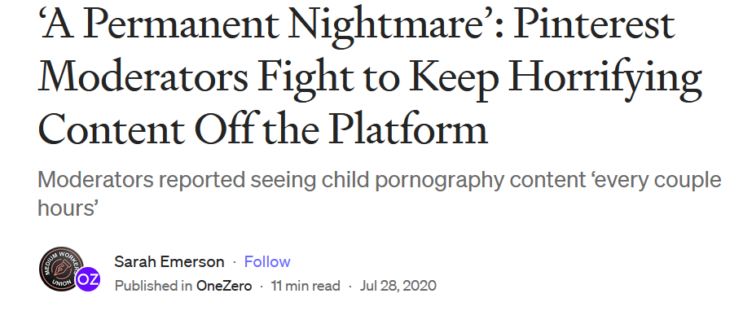
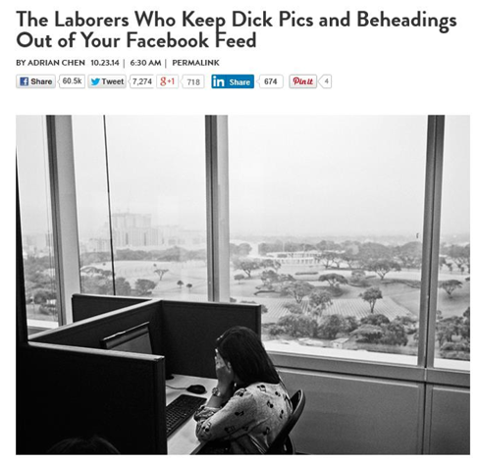
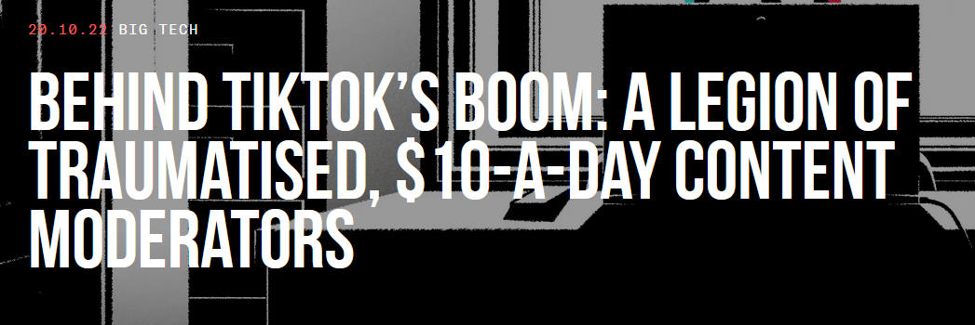
The need for humans
Many examples where humans are involved
Adult content and moderation
Baby sitting algorithms
https://onezero.medium.com/a-permanent-nightmare-pinterest-moderators-fight-to-keep-horrifying-content-off-the-platform-4d8e7ec822fe
https://www.wired.com/2014/10/content-moderation/
https://www.thebureauinvestigates.com/stories/2022-10-20/behind-tiktoks-boom-a-legion-of-traumatised-10-a-day-content-moderators

Slide 27
Problems
Monolithic HITs
The structure of a HIT mirrors the structure of the task the developer is working on
Similar to Conway’s law in software engineering
Task complexity
Lengthy instructions
RTFM doesn’t work
We don’t think of HC/crowdsourcing as programming
How to improve
Use established programming practices
Careful, we are dealing with humans and not machines

Slide 28
A spectrum of labeling tasks
Nature of task | Aggregation approach | Evaluation technique
Objective question has a correct answer (objective) | Reliable judge assigns appropriate label for an item | Evaluate workers by comparing individual results with gold set
Judgment question has a best answer (partially objective) | Inter-rater agreement determines label for an item | Evaluate workers by comparing individual results with consensus
Subjective question has consistent answer (subjective) | Repeatable polling determines probability of a label for an item | Evaluate workers by computing the consistency of results between groups

Slide 29
Prepare the environment
Homework before you label
Assess the lay of the land
Identify your use cases
Understand your product’s data
Design your HITs
Determine your guidelines
Communicate your task
Maintain high quality
Ongoing vs. one-offs HITs
Labels for the machine != labels for humans

Slide 30
HIT design principles
Self-contained, short, and simple
Document presentation
Text alignment & legibility; reading level; multi-cultural and multilingual
Cognitive biases
Implications on the final output: anchor effect, mere exposure, picture superiority
Task complexity
High cognitive load; low usability, specific expertise

Slide 31
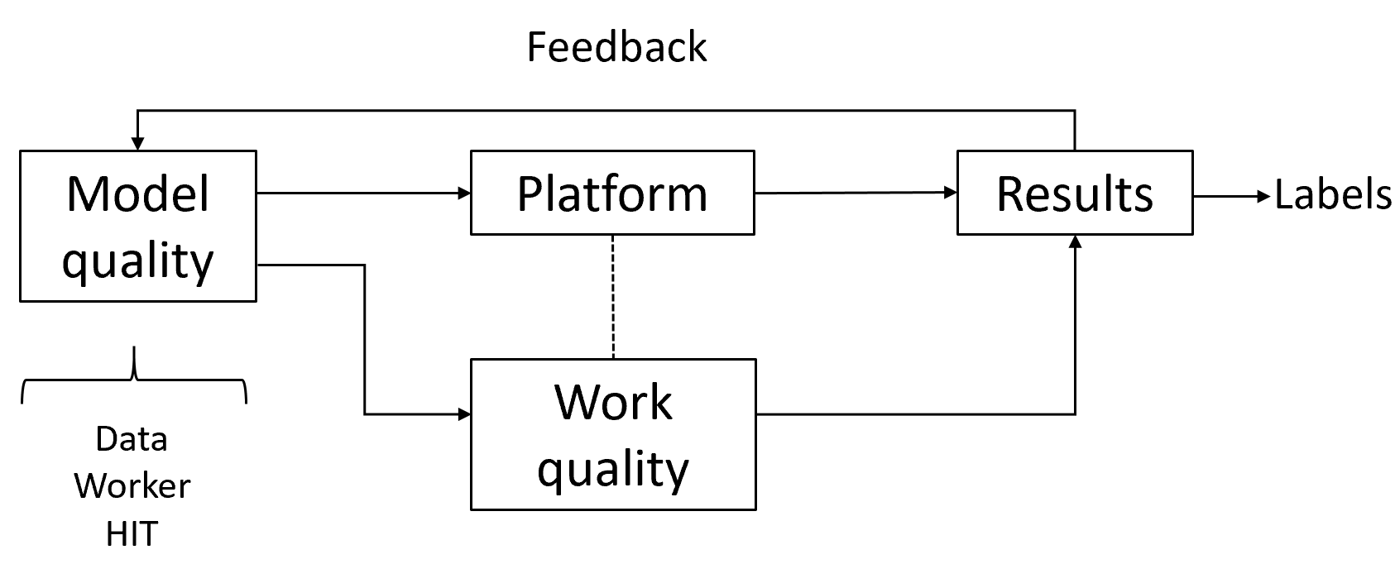
Quality control in general
Extremely important part of the task
Approach as “overall” quality; not just for workers
Bi-directional channel
You may think the worker is doing a bad job.
The same worker may think you are a lousy requester.
Quality framework
Module quality
Work quality
Measuring agreement

Slide 32
Algorithms used in practice
Voting
Majority vote, Borda, tiers
Strong baseline
Honey pots and programmatic gold
Expectation-Maximization
Get another label
Adaptivity
Quality-cost tradeoff
How many workers?
When to stop?
Stopping rules
Automatic honey pots creation

Slide 33
Behavioral features
Focus on the way workers work instead of what they produce
Task fingerprinting
High correlation with work quality
Wernicke
Information Extraction scenario
Weighted majority voting
Behavioral features outperform performance-based methods
J. Rzeszotarski and A. Kittur. “Instrumenting the Crowd: Using Implicit Behavioral Measures to Predict Task Performance”. UIST 2011.
S. Han, P. Dai, P. Paritosh, D. Huynh. “Crowdsourcing Human Annotation on Web Page Structure: Infrastructure Design and Behavior-Based Quality Control”. ACM TIST 2016

Slide 34
Active learning
Accuracy
Limited budget for annotating a small % of the unlabeled data
Speed
Model more accurate more quickly
Diversity
Uncertainty sampling
Least confidence, margin of confidence, ratio of confidence
Diversity sampling
Clustering to partition the data, real-world diversity
R. Munro. “Human-in-the-Loop Machine Learning”, Manning Publications 2021.

Slide 35
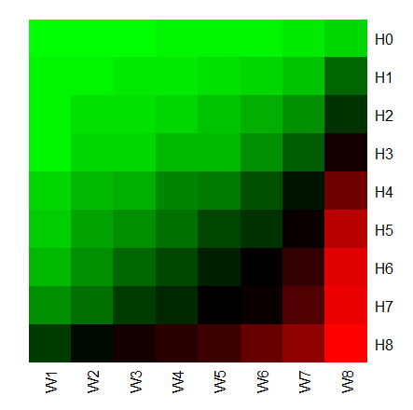
Error rates for different worker/HIT groups
Easy HITs
UHRS
2,700 HITs from 20 workloads
For difficult HITs
Good workers are doing well
Bad workers are doing poorly
For easy HITs
Good workers are doing well
Bad workers are doing well
Difficult HITs
Let error(Wi, Hj) be the average error rate of the
workers in the worker group Wi working on HITs Hj
Good workers
Bad workers
I. Abraham et al. “How Many Workers to Ask? Adaptive Exploration for Collecting High Quality Labels”. SIGIR 2016

Slide 36
Snorkel approach
Formalizing programmatic labeling
Models are commodities
pip install <what-you-want>
Training data is the interface for software 2.0
Labeling functions as black boxes that predict a label
Learn from agreements/disagreements between labeling functions

Slide 37
LLMs
Human labels are expensive
Expert > Crowd-based worker > LLM
Automatic label is not a new idea
How about using LLMs to label documents?
Potential advantages
Cost and performance
Allocate humans where are needed the most
Potential issues
Reliability
Quality control
P. Thomas et al. "Large language models can accurately predict searcher preferences" arxiv.org/abs/2309.10621
G. Faggioli et al. "Perspectives on Large Language Models for Relevance Judgment" ICTIR 2023

Slide 38
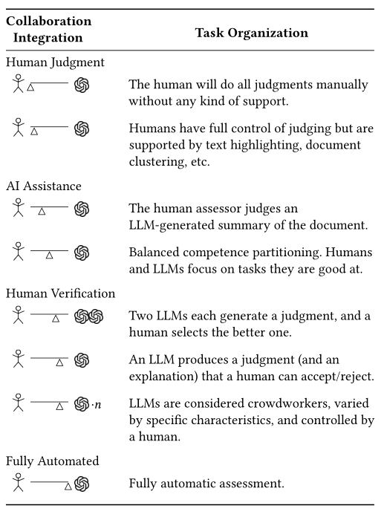
Spectrum of human-machine collaboration
LLMs judgement quality
LLMs cost
Multiple LLMs as judges
Truthfulness
Bias
Explanations/justifications

Slide 39
Prompting
In-context learning
New capabilities can be unlocked in LLMs
LLM is prompted with a few in-context demonstrations
Learns to perform a certain task
Task performance is very sensitive to prompts

Slide 40
Setup
Similar to crowdsourcing work
Take TREC judgement guidelines
HIT in Mturk
Prompt for GPT or similar LLM
Compute agreement using Cohen’s kappa
Two main approaches
Prompt “as is”
Prompt engineering

Slide 41
Prompt structure
Relevance evaluation task
Task instructions
You are a search quality rater evaluating relevance of web pages
Query-document pair to be labelled
Query {query}
Document {document}
Relevant?
Re-state the task
Output format

Slide 42
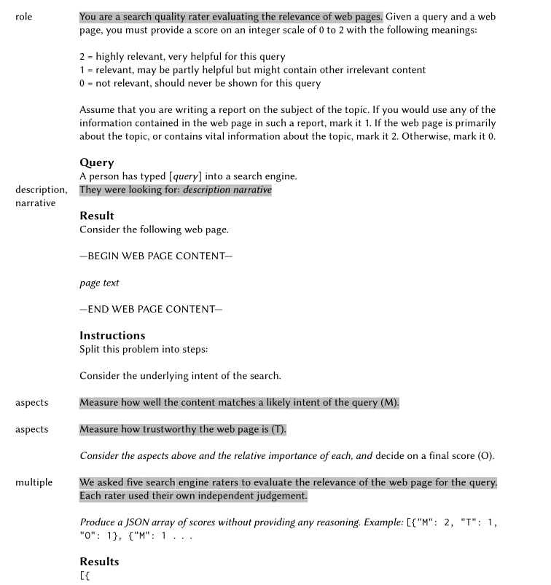
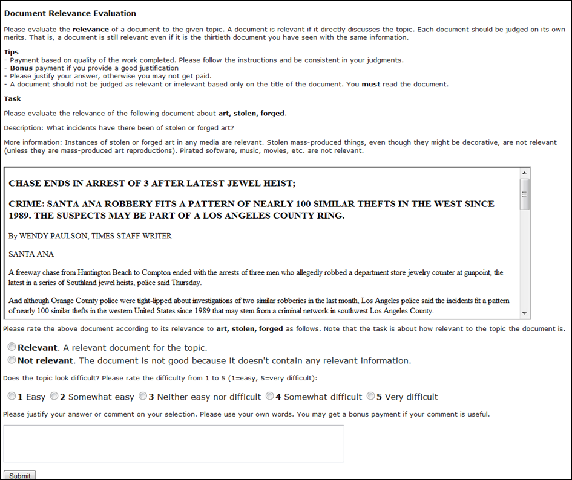
Prompts compared to HITs

Slide 43
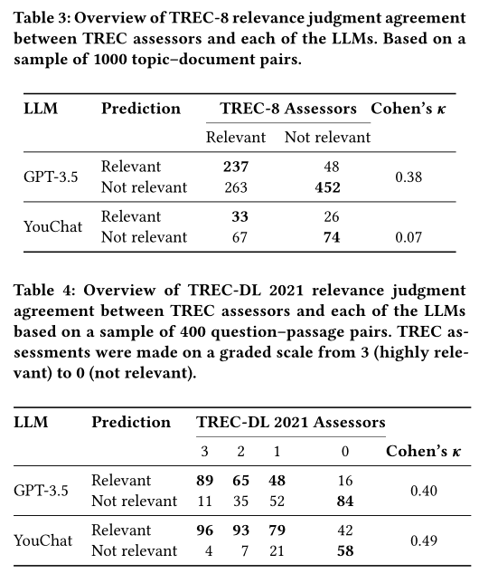
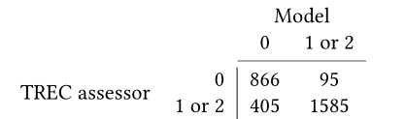
Preliminary results
With no prompt engineering
With prompt features
R (role), D (description), A (aspects), M (multiple judges)
Performance varies per feature
Cohen’s k (0.20 to 0.64)

Slide 44
Discussion
In favor
LLMs are able to produce an explanation
This could be used to assist humans in relevance judgements
Against
LLMs are not users
IR is about relevance to an information need
No proof that evaluation by LLM has any relationship to reality
Things to consider
Reliability over time
Cost in prompt engineering
Caveat
LLMs are systems
Query intent and answer construction

Slide 45
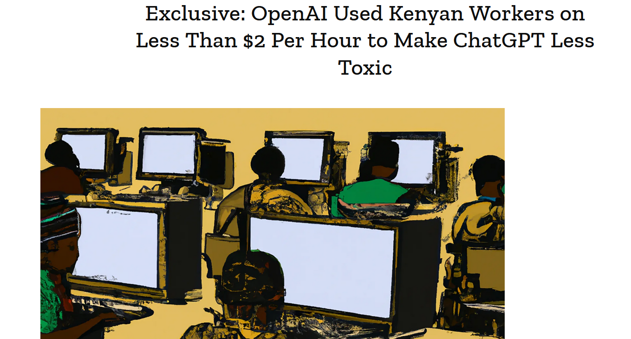
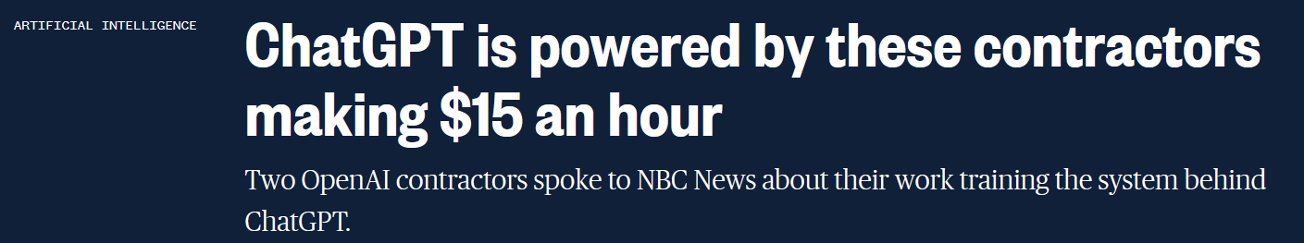
LLMs and human computation
For a LLM like ChatGPT, p(w_{i}|w₁,…,w_{i-1}) is defined by a transformer
LLM-based system do require editorial work
Not different from any major property on the Internet
https://time.com/6247678/openai-chatgpt-kenya-workers/
https://www.nbcnews.com/tech/innovation/openai-chatgpt-ai-jobs-contractors-talk-shadow-workforce-powers-rcna81892

Slide 46
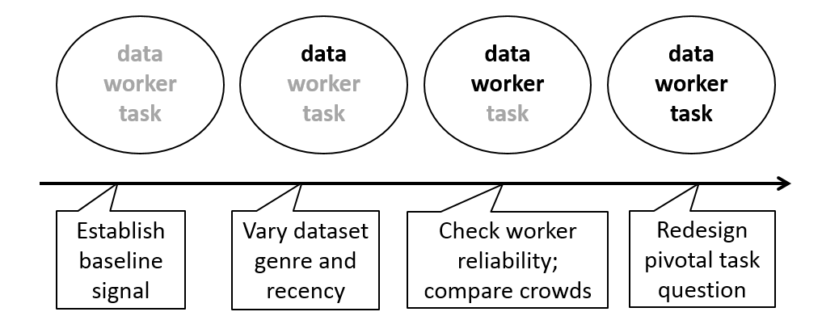
The main process is unchanged
Regardless if labeling is done by machines or humans
Three main components
Task design
HIT or prompt engineering
Data
Crowd
Human-based crowd or LLM-based crowd
Quality control
Debugging
 | Machine computation | Human computation
Design | Throw away | Reluctant to throw away
Testing | Systematic | Ad-hoc
Debugging | Programmer’s fault | Worker’s fault
J. Attenberg, P. Ipeirotis, F. Provost. “Beat the Machine: Challenging Humans to Find a Predictive Model’s ‘Unknown Unknowns’”. ACM JDIQ 2015

Slide 47
Too many (irrelevant) tasks
SciRepEval example
There are so tasks that
some will be more relevant to our use cases,
and others will be less relevant
The FoS task, for example, classifies documents into 23 fields of study.
The FoS task is probably not relevant to recommendation use cases

Slide 48
Principles (Conclusion)
Characterize use case & audience
Validity:
Relevance of task to use case
Reliability:
Inter-rater agreement
Realistic workloads
Labeling and annotation
Documentation:
How was it done?
Availability of instructions
Maintenance
Include a feedback loop mechanism to maximize adoption
Workload Evolution
Lessons learned and addendum(s)
Lifecyle and deprecation
High standards
(for high-stakes use cases)
Use of established software engineering and data management techniques
(e.g., code review, versioning, configurations, dependencies, and testing).
How was the data sourced?
Provenance?
Can we data set be generated again easily?
Clean and well-documented data model

Slide 49
Ugly: Outline
Benchmarking (Omar)
Smooth-Talking Machines/Trust (Ken)

Slide 50
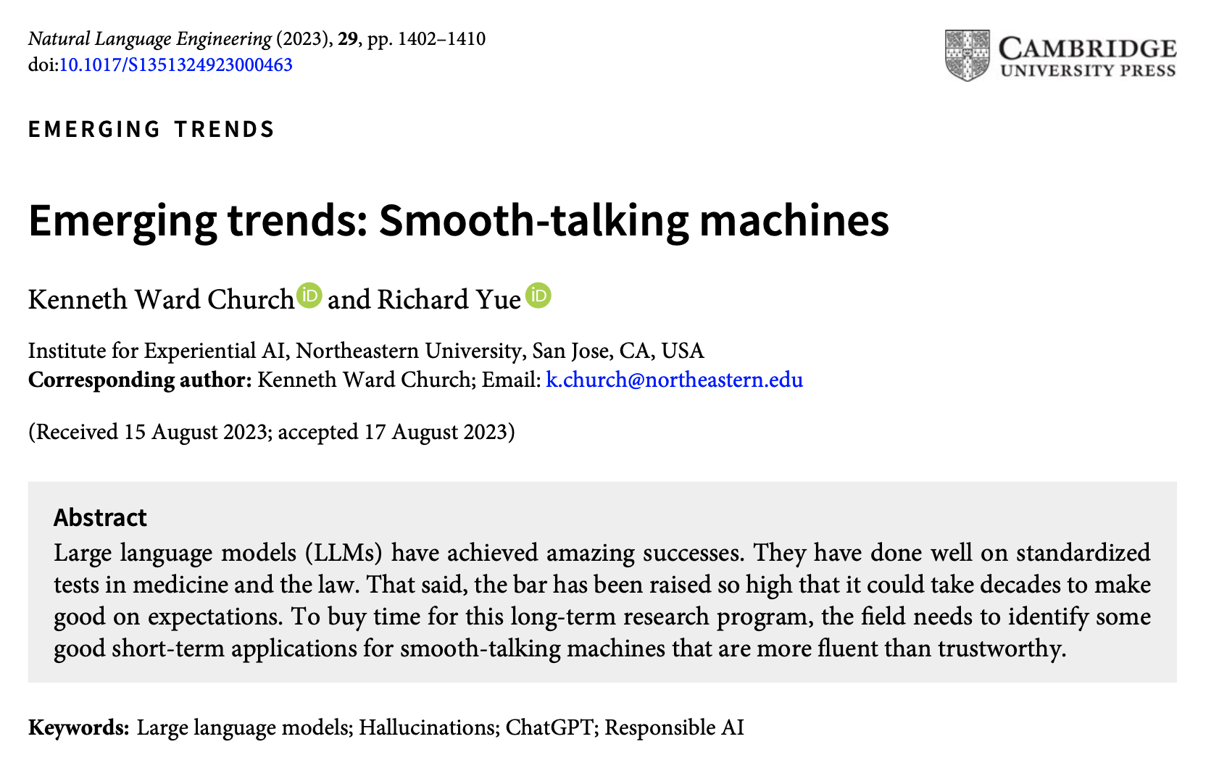


Slide 51
Too Good to be True
Standardized tests in medicine, law, etc.
Press
ChatGPT is, quite simply, the best artificial intelligence chatbot ever released to the general public. -- New York Times
Back-peddling
You shouldn’t expect a computer to hang a shingle... anytime soon, but...
It’s best to think of ChatGPT as autocomplete on steroids...
anyone who uses the internet knows that
the internet is, well, not always accurate.
What’s more, we don’t know precisely what information ChatGPT is being fed.

Slide 52

Fluency $≠$ Intelligence
People want to believe in chatbots
What is the difference between a hallucination and a con?

Slide 53

https://didapelled.bandcamp.com/track/smooth-talkin-con-man
Smooth talking, soft spoken, con man
Smooth talking, soft spoken, con man
You stole all of my love
Then you washed me off your hands
Your words were well reversed lies
You make me change my mind
…
Now I’m smooth talking swinging too
…
Smooth talkin’, smooth walkin’
soft spoken, slick workin’
hip swinging, fast talkin’ too

Slide 54
Good Applications for Smooth-Talking Machines
There have been booms and busts in AI
Busts → AI Winters
Good Applications for Crummy Machine Translation – Church & Hovy (1993)
Even though machine translation did not work very well at the time,
we argued that it would help advance the field in the long-term
to look for promising short-term use cases.
We needed a few quick successes to support the field
to buy time for longer-term investments in more fundamental improvements.
It was clear at the time that
it would take decades to make good on expectations.
Similar comments apply to LLMs.
The bar has been raised so high that it could take decades to make good on expectations.
In the meantime, we should be on the lookout for short-term quick hits
to buy time for more fundamental improvements.

Slide 55

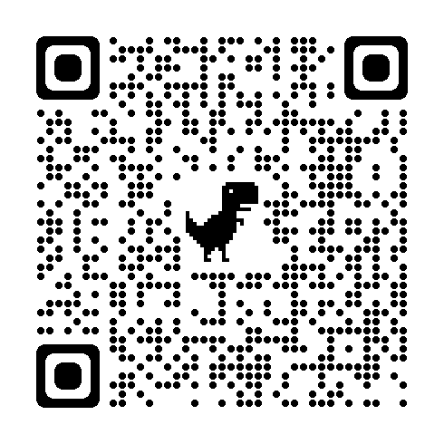
https://www.chronicle.com/article/im-a-student-you-have-no-idea-how-much-were-using-chatgpt

Slide 56
Essay Writing Subtasks: Human-machine Collaboration
Chatbots are good at
Chatbots are not good at
Thesis statements
Outlines
Capturing student’s voice
Quotes (makes them up)

Slide 57
Is it cheating to use a chatbot?
Yes
No
According to Owen Terry, author of
You have no idea how much we’re using ChatGPT
A professor, Inara Scott, on NPR
https://www.wbur.org/hereandnow/2023/05/22/chatgpt-academia
Creative way to learn creative writing

Slide 58
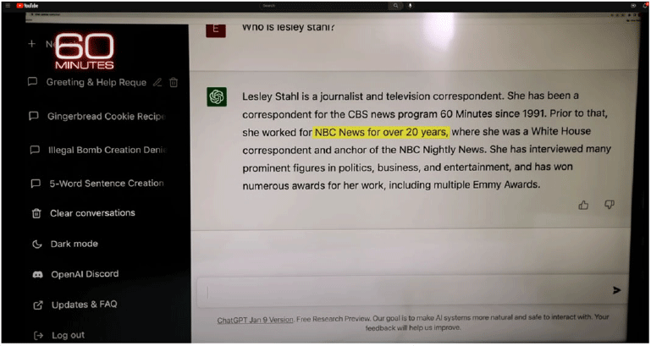
Good applications: Take advantage of strengths and avoid weaknesses
Strengths
Weaknesses
Thesaurus
Fluency
Hallucinations
Complement with fact-checking

Slide 59
Smooth-Talking Conclusions
Low Road: Give up; hallucinations are too hard
Middle Road: Use search to verify assertions (fact-checking)
High Road: Revive Rationalism
1950s: Empiricism (Firth, Harris, Skinner)
1970s: Rationalism (Minsky, Chomsky)
1990s: Empiricism (EMNLP)

Slide 60
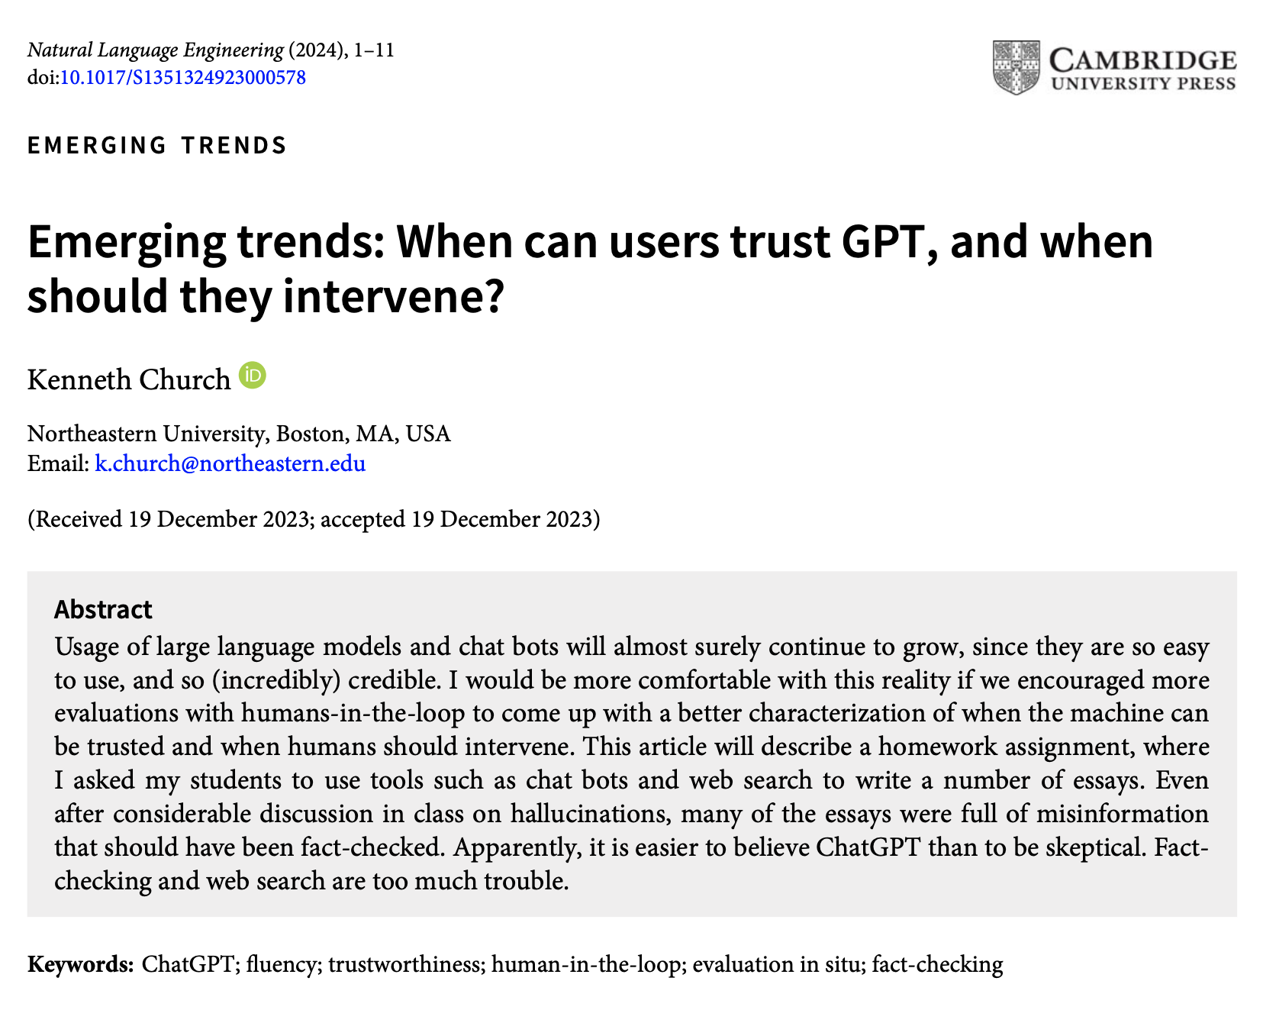


Slide 61
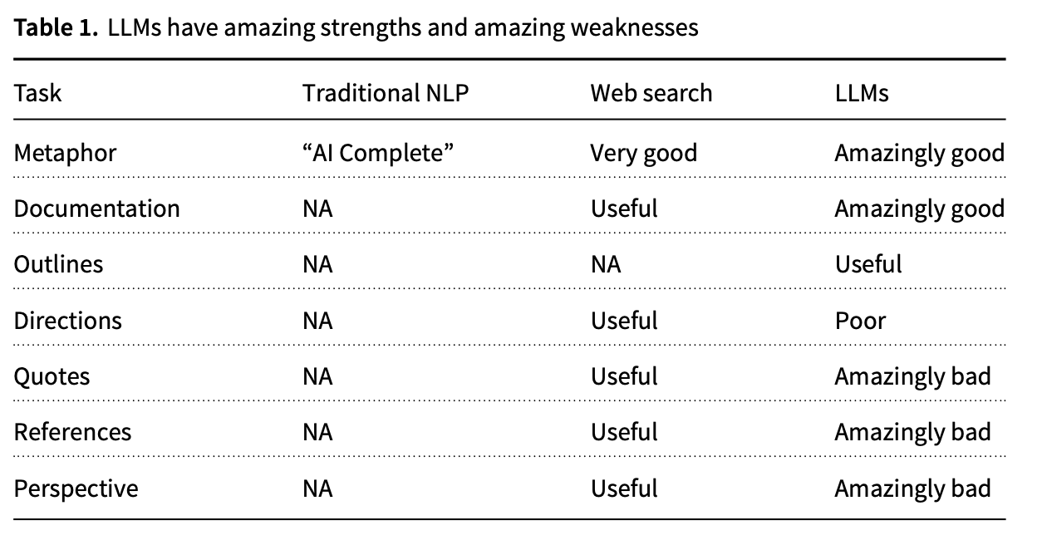
Evaluation of Human-in-the-Loop Homework: use tools to help them write essays

Slide 62
Use Cases: Some work well and some do not
Amazingly Good
Amazingly Bad
cover all the bases
drop the ball
dunk
fumble
get on base
hit a home run
out in left field
ragging the puck
sticky wicket
Made-up Reference
Title: “A Survey of Nearest Neighbor Search Algorithms”
Authors: Yufei Tao, Dongxiang Zhang
Link: Survey Paper (link to https://arxiv.org/abs/1904.06188)

Slide 63
During the First Opium War (1839–1842),
the British government was led by the Conservative Party under Prime Minister Sir Robert Peel.
The opposition, primarily the Whigs, had varying views on the war.
Some opposed it on moral grounds, criticizing the ethics of trading in opium,
while others were concerned about the potential impact on international relations and trade.
Factual Errors
Lack of Depth/Perspective
Question for students
What were the Opium Wars?
Where did the name come from?
Summarize the conflict from multiple perspectives, including:
England
China
India
United States
France

Slide 64
In fact, the Opium War had little to do with opium
Neither the government (Whigs) nor the opposition (Conservatives)
supported drugs.
The Whigs had just abolished slavery
and viewed drugs to be a form of slavery.
The conservatives viewed drugs as bad for business (in textiles and tea).
The name of the conflict, Opium Wars, comes from an editorial on March 23, 1840, in the conservative newspaper: The Times, which argued that
The British would be saddled with the massive expense of an unnecessary foreign campaign
that would cost far more than the entire value of the lost opium. Platt (2019), p. 393.
The government was put in an awkward corner because, Charles Elliot, their representative in China mishandled the situation.
He convinced the smugglers to give him their drugs in return for British IOUs,
and then he handed over the drugs to the Chinese authorities for destruction.
When Parliament did not want to make good on the IOUs,
they thought they could force
the Chinese to pay for the lost opium.

Slide 65

Lack of Perspective → Danger Chatbots $≠$ Historian (Platt)
Most of the essays from the students repeated output from ChatGPT more or less as is.
These essays contained factual errors,
but more seriously,
the essays lack depth and perspective.
In Platt (2019), p. 444, Platt argued that Napoleon understood that
it would be foolish for Britain to use its short-term advantage in technology to humiliate the Chinese.
Eventually, the Chinese would do what they have done (become stronger).
Since the 1920s, these events are referred to as
the “century of humiliation”
by the authorities in China.
Platt makes it clear that
the current Chinese government is using this terminology
to motivate its efforts to compete with the West in technologies such as AI
When we discussed these essays in class, I tried to argue
that over-simplifying the truth, and
taking the Western side of the conflict,
could be dangerous and could lead to a trade war, if not a shooting war

